Slide 1
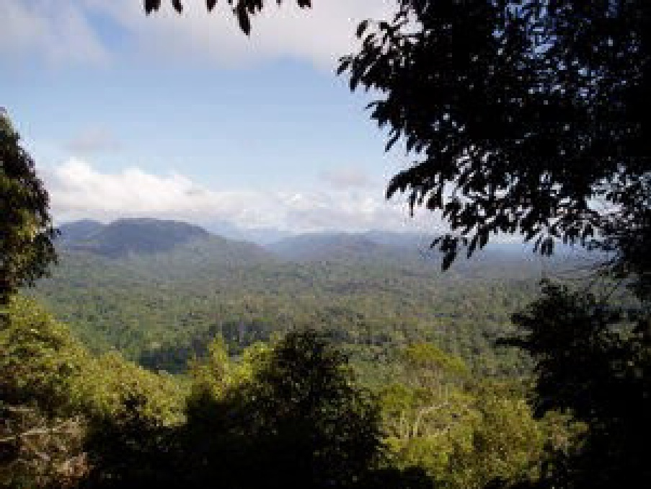
BIODIVERSITY
AND
ITS
CONSERVATION

Slide 2

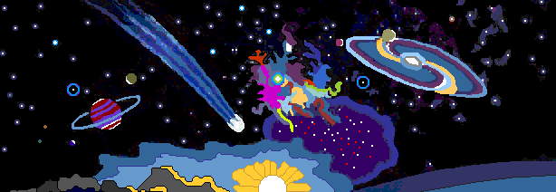
Formation of universe began 15 billion years ago, clouds of the hydrogen and helium
Gravitational forces collapsed these clouds to form stars.
Formation of carbon, nitrogen, and oxygen, for life.
explosions of some of these stars to form clouds
Formation of water, carbon monoxide, and hydrocarbons .
Formation of new generation of stars and solar systems by collapsing clouds.
Formation of the planet Earth (with volcanoes, a gray, lifeless ocean, and a turbulent atmosphere)
origin of life on the planet Earth

Slide 3
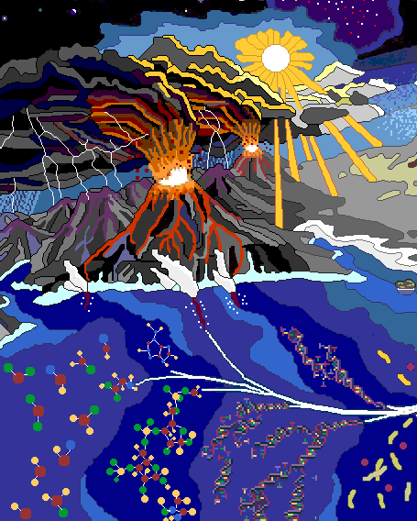
The Prebiotic Earth
Life began 4.5 billion years ago on the Earth .
The ocean received organic matter.
Formation 0f key molecules such as sugars, amino acids, and nucleotides in water.
development of RNA and DNA molecules.
Formation of prokaryotic cell and prokaryotic organisms.

Slide 4
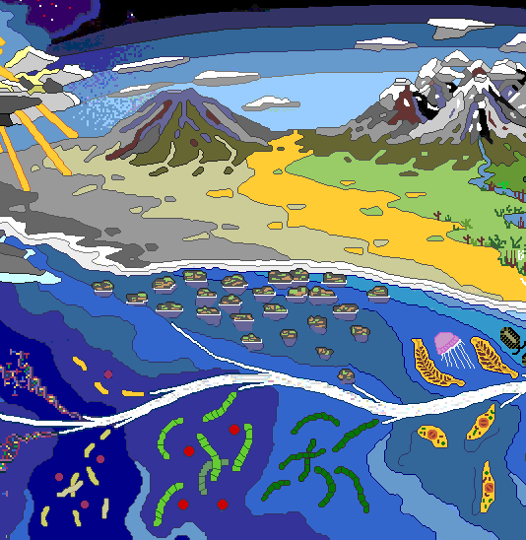
The Early Evolution of Life
Biochemical evolution of single-celled microorganisms.
Development of eukaryotic cell and unicellular eukaryotic organisms between 1 and 2 billion years ago
Development of multicellular complex eukaryotic organisms primitive jellyfish and two Ediacarian "sea pens."

Slide 5
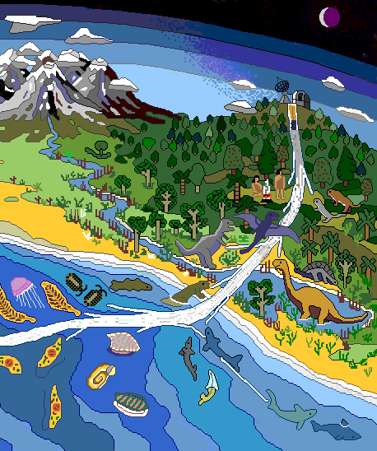
Evolution of Advanced Life
Evolution of Organisms
prokaryotic organisms
Eukaryotic unicellular organisms
Animals Plants
Invertebrates Algae
Fishes Bryophytes
Amphibians Pteridophytes
Reptiles Gymnosperms
Mammals, Angiosperms
Humanity.

Slide 6

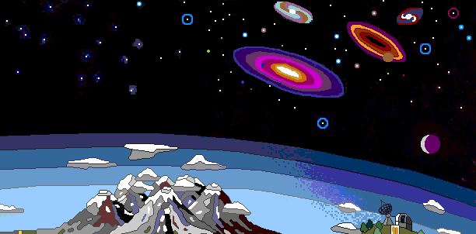
Given the huge number of stars known to exist in the universe, life has very likely also developed elsewhere. we just might be able to detect it.

Slide 7
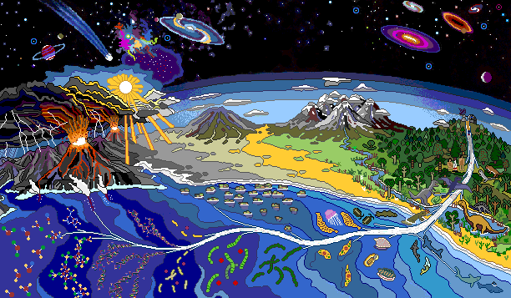

Slide 8

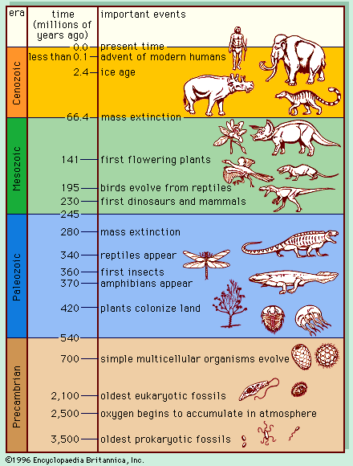

Slide 9

DEFINITION
Biodiversity or biological diversity is
the variation of taxonomic life forms
within a given ecosystem,biome or for
the entireEarth.
Biodiversity refers to variety and variability among all groups of living organisms and the ecosystemcomplexes in which they occur.

Slide 10


LEVELS OF BIODIVERSITY
Biodiversity ranges from the genetic level within a species to the biota in a specific region and may extend up to the great diversity found in different biomes.
Genetic Diversity - diversity of genes within a
species. There is a genetic variability among the
populations and the individuals of the same species.
Species Diversity - diversity among species in anecosystem. “Biodiversity hotspots" are excellent
examples of species diversity.
Ecosystem Diversity - diversity at a higher level of organization, the ecosystem.

Slide 11
Vertebrate Animals Invertebrate Animals
Mammals | 5,490
Birds | 9,998
Reptiles | 9,084
Amphibians | 6,433
Fishes | 31,300
Insects | 1,000,000
Spiders and scorpions | 102,248
Molluscs | 85,000
Crustaceans | 47,000
Corals | 2,175
Others | 68,827
Total Vertebrates |  | 62,305
Total Invertebrates |  | 1,305,250
Plants
Flowering plants (angiosperms) | 281,821
Conifers (gymnosperms) | 1,021
Ferns and horsetails | 12,000
Mosses | 16,236
Red and green algae | 10,134
Others
Lichens | 17,000
Mushrooms | 31,496
Brown algae | 3,067
Total Others |  | 51,563
TOTAL SPECIES |  | 1,740,330
Total Plants |  | 321,212

Slide 12
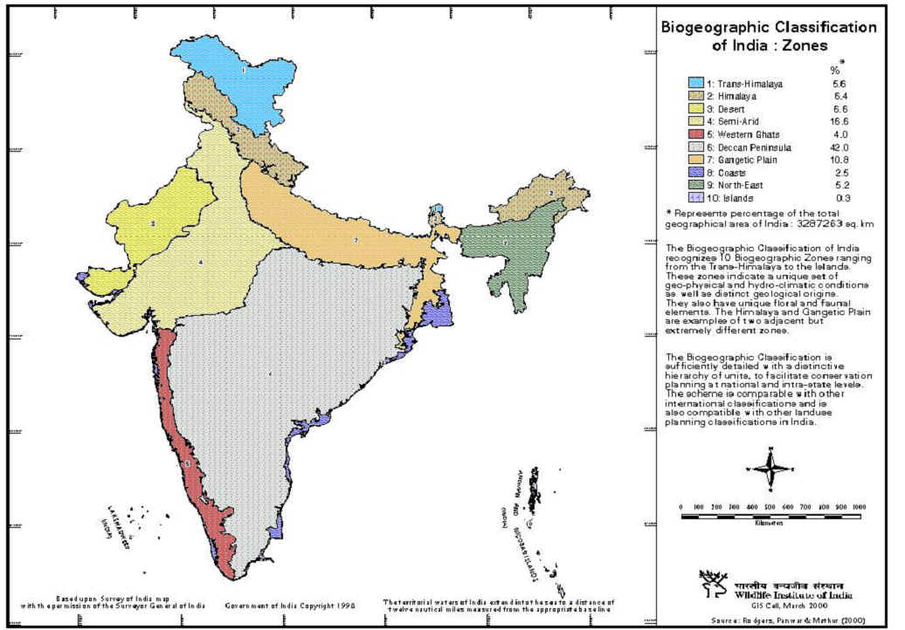

Slide 13
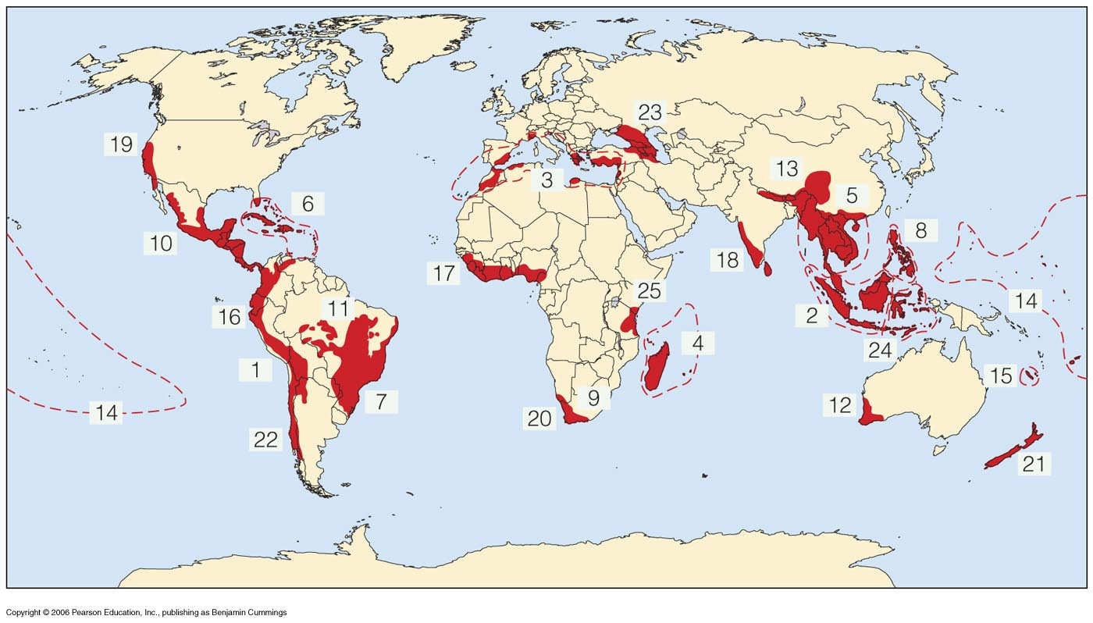
Biodiversity Hot Spots

Slide 14
VALUE OF BIODIVERSITY
In terms of
≈Commercial Utility
≈Ecological Services
≈Social and Aesthetic Value
The multiple uses of Biodiversity or Biodiversity are as fallows

Slide 15

» Consumptive Use Value
»Productive Use Value
»Social Value
»Aesthetic Value
» Option Value
»Ecosystem Service Value

Slide 16

Consumptive Use Value
Food
- 80,000 edible plant species
- 90% of food crops domesticated from wild tropical plants
Drugs and Medicines
- 75% of world’s population depends
upon plants or plant extracts for medicines eg. Penicillin,Tetracyclin

Slide 17
Energy resources
Fuel
- Forests used for Fuel Wood.
- Fossil fuels Coal, Petroleum and
Natural Gas are also products of fossilized biodiversity
Different furniture’s

Slide 18
Productive Use Value
Commercially usable values where the product is marketed and sold
»Wild Gene Resources – traded for use by
scientists for introducing desirable traits in
the crops and domesticated animals
»Others – Tusks of Elephants, Musk from
Musk deers, Silk from Silk Worms, Wool
from Sheep etc.
Biodiesel Petroleum products

Slide 19
Industries dependant upon the productive use value of Biodiversity
Paper and Pulp
Play wood
Rubber
Textile
Leather

Slide 20
Social Value
Social Value
Values associated with social life,
customs, religion and psycho-spiritual
aspects of the people
→ Plants like Tulsi, Peepal, Mango, Lotus etc. are considered holy and their leaves, fruits and flowers are used in worship.

Slide 21

Ethical Value
Ethical issues like “ all life must be
preserved”.
Based on the concept of “ Live and Let Live”.

Slide 22
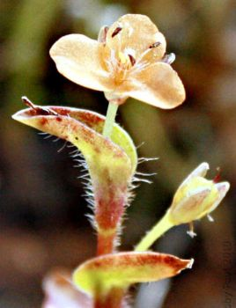
Option Values
Values include the potential of Biodiversity that are presently unknown and need to be explored.
Option value is the value of knowing that there are biological resources on this biosphere that may one day prove to be an effective option for something important in the future.
Murdannia’ genus

Slide 23
Aesthetic Value
“ Willingness to pay” concept
→ Eco-tourism
Eco-tourism is estimated to generate about 12 million dollars of revenue annually.

Slide 24
What is risk ?
Different categories of biodiversity value clearly indicate that ecosystem, species and genetic biodiversity all have enormous potential and a decline in biodiversity will lead to huge economic, ecological and socio-cultural losses.

Slide 25
India as megabiodiversity nation
Two hot spots in India

Slide 26
Endangered species
An endangered species is a population of organisms which is facing a high risk of becoming extinct because it is either few in numbers, or threatened by changing environmental or predation parameters
Endemism is the ecological state of being unique to a defined geographic location, such as an island, nation or other defined zone, or habitat type; organisms that are indigenous to a place are not endemic to it if they are also found elsewhere.

Slide 27
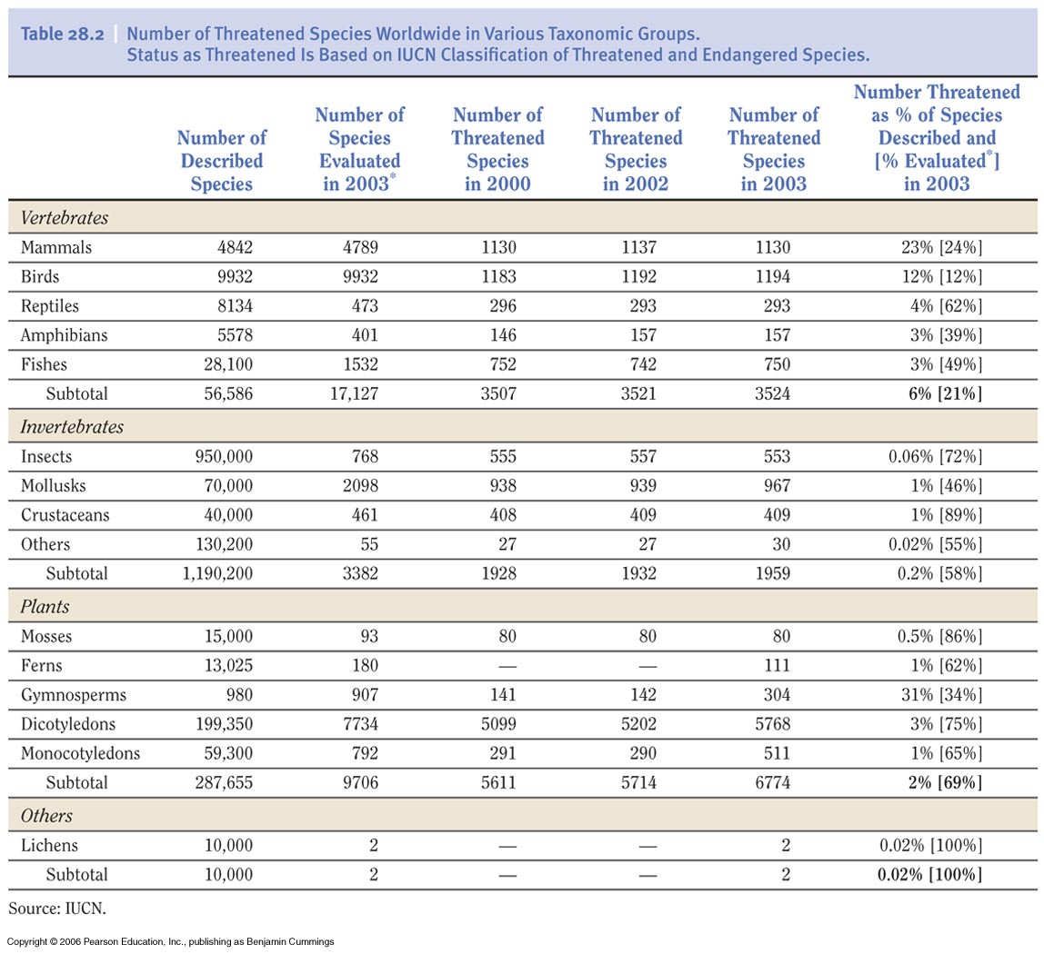

Slide 28

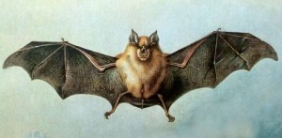
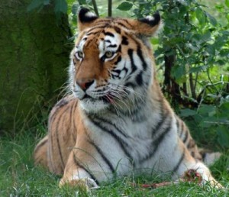
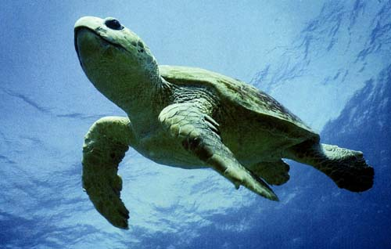
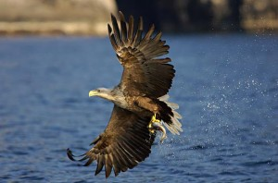
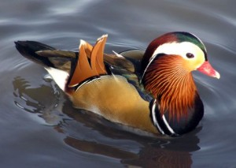
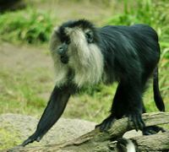
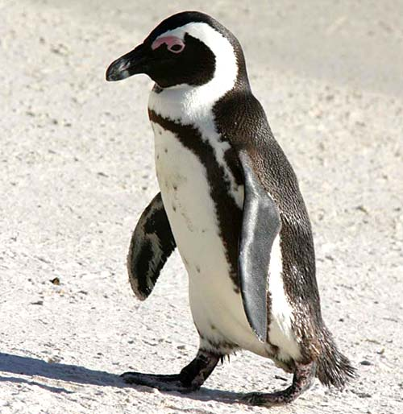
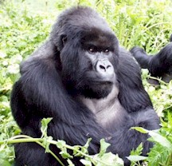
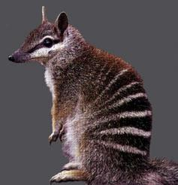
Most Endangered species

Slide 29
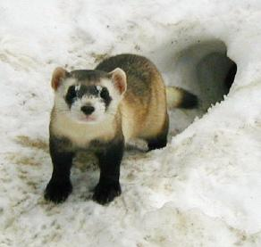
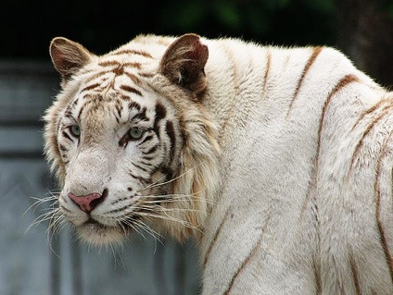
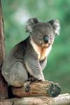
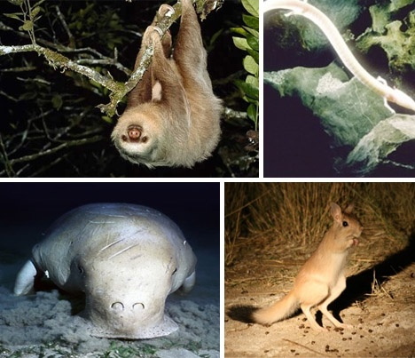
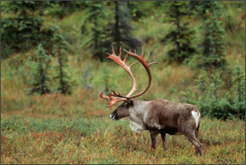

Slide 30
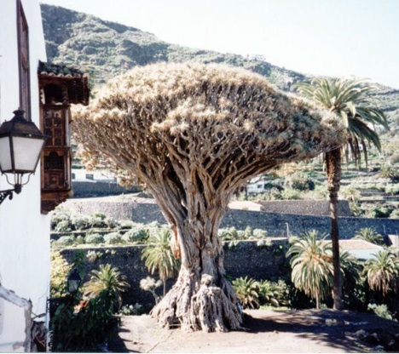
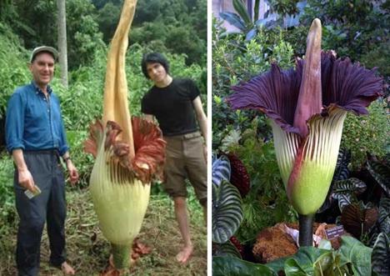
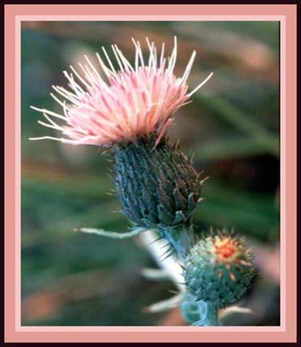
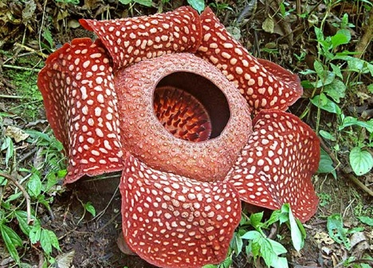
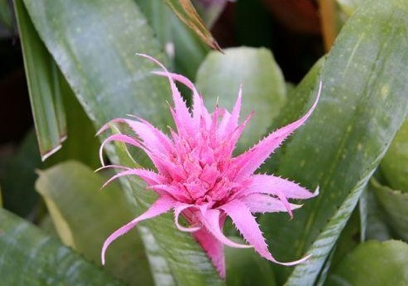
Most Endangered plant species

Slide 31
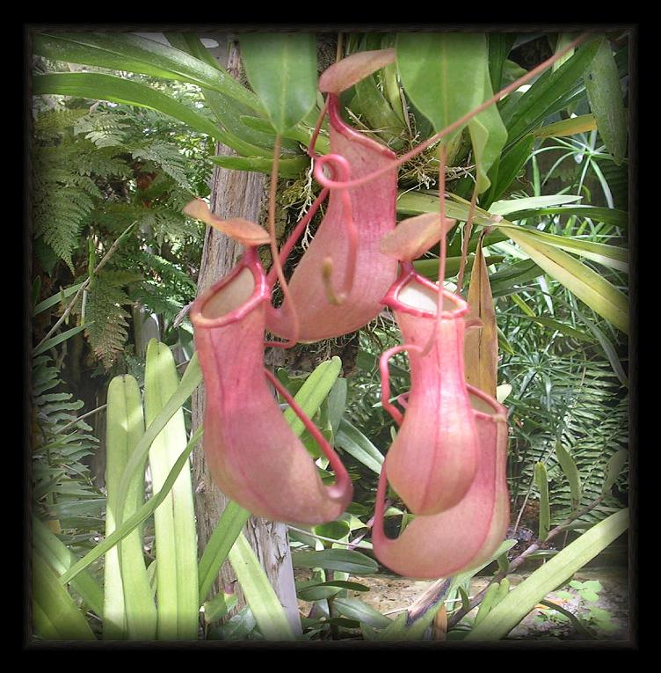
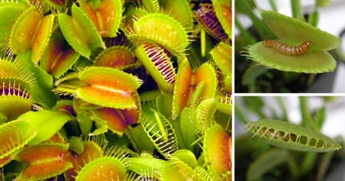
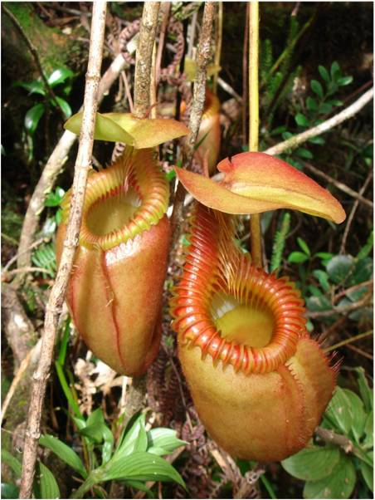
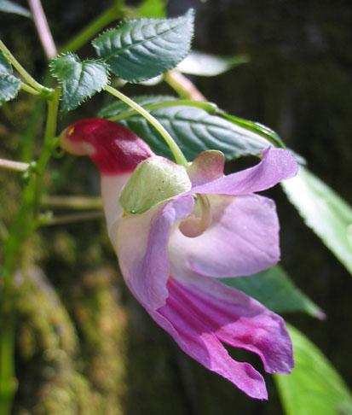
Picture plant

Slide 32
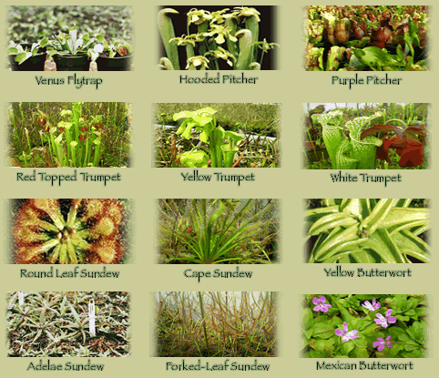

Slide 33
BIOGEOGRAPHICAL CLASSIFICATION
OF INDIA
Climate and Topography
Variety of Flora and Fauna
Rich heritage of Biological Diversity
10 th position among plant rich nations of the world

Slide 34
Different groups in India.
Group | (%) IN INDIA
Mammals | 7.6
Birds | 12.6
Reptiles | 6.2
Amphibians | 4.4
Fishes | 11.17
Flowering Plants | 10.11

Slide 35
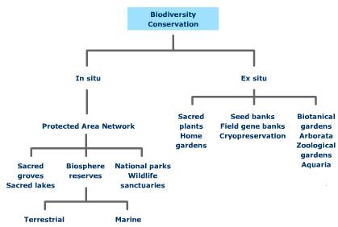

Slide 36

Thank You

